Slide 1

Cost/Loss Function

Slide 2
Cost/Loss Function(C)
It refers to error or loss in dataset.
It measures the difference actual output between predicted output from model.
Cost function is the average of error for entire training dataset.
Loss function is the error of the individual data point.
Good model gives less error.

Slide 3
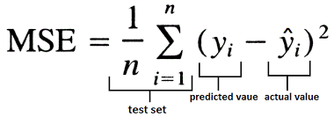
Types of error in ML
Mean square error(MSE)/L2loss

Slide 4
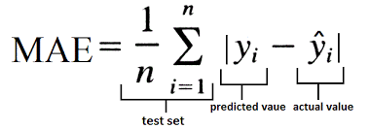
Mean Absolute error/L1 loss:

Slide 5
Gradient Descent
Machine learning optimization algorithm used to minimize the cost function so we can get the models that have accurate prediction.
It is basically that, we just need to change the parameter manually until we find minimum cost.
In machine learning, we use gradient descent to update the parameters of our model. Parameters refer to coefficients in Linear Regression and weights in neural networks.
We calculate the gradient ∂c/∂ω which is the partial derivative of cost with respect to weight.
Is learning rate, helps to adjust the weight w.r.t. gradient descent.
It helps to find global minimum.

Slide 6
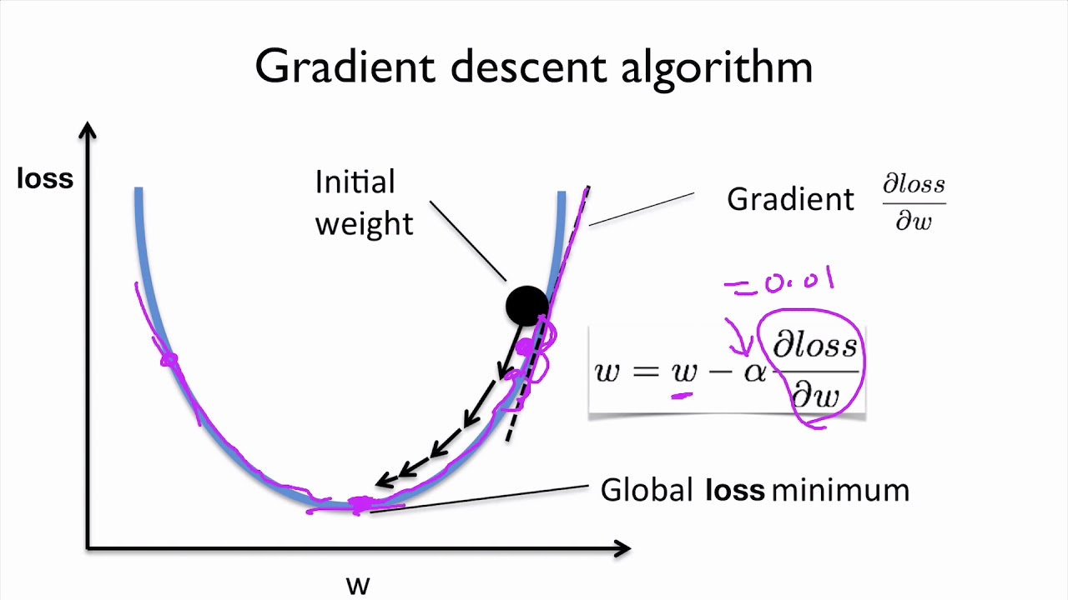

Slide 7
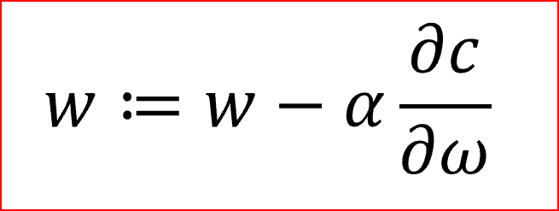
Derivation of Y = X^2
Dy/dx = 2X
If x = 10, Y=30..
Dy/dx = 2*10=20
Xnew = 5-0.1*20
Xnew=3
Y=17
Xnew=Xold – learning rate * y/dx

Slide 8
Types of Gradient Descent
Batch Gradient Descent:
This is a type of gradient descent which processes all the training examples for each iteration of gradient descent.
If the number of training examples is large, then batch gradient descent is computationally very expensive.
If the number of training examples is large, then batch gradient descent is not preferred.
It is time taking and slow as the large dataset may not fit into the memory.
Batch size is full dataset.
It is easy to understand the analysis of weight and convergence rate.

Slide 9
Stochastic Gradient Descent:
This is a type of gradient descent which processes 1 training example per iteration.
The parameters are being updated even after one iteration in which only a single example has been processed.
This is quite faster than batch gradient descent.
When the number of training examples is large, even then it processes only one example which can be additional overhead for the system as the number of iterations will be quite large.
As we frequently update weights, cost function fluctuate heavily.
Batch size is 1.

Slide 10
Minimum Batch Gradient Descent:
This is a type of gradient descent which works faster than both batch gradient descent and stochastic gradient descent.
In this type gradient, instead of a single training example, the dataset is divided into groups i.e. mini. batch of sample that used to calculate model error and update the model coefficient.
It speeds the learning.
Helps to get actual global minimum.
Loss is computed for each mini batch and hence total loss needs to be accumulated across all mini batches.

